Slide 1
Table tag

Slide 2
Tables:
Table Parts
Before getting into the actual HTML code to create a table, let's look at the following terms so that we both know what we're talking about:
The caption indicates what the table is about: for example, "Voting Statistics" or "Toy Distribution Per Room" Captions are optional.
The table headings label the rows, columns, or both. Usually they're in an emphasized font that's different from the rest of the table. They're optional.
Table cells are the individual squares in the table. A cell can contain normal table data or a table heading.
Table data is the values in the table itself. The combination of the table headings and table data makes up the sum of the table.
The <table> Element
The to create a table in HTML, you use <table>...</table> element to enclose the code for an optional caption, and then add the contents of the table itself:
<table>
...table caption (optional) and contents...
</table>
Rows and Cells
The cells within each row are created using one of two elements:
<th>...</th> elements are used for heading cells. Generally, browsers center the contents of a <th> cell and render any text in the cell in boldface.
<td>...</td> elements are used for data cells. TD stands for table data

Slide 3
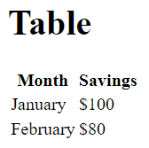
<table>
<tr>
<th>Month</th>
<th>Savings</th>
</tr>
<tr>
<td>January</td>
<td>$100</td>
</tr>
<tr>
<td>February</td>
<td>$80</td>
</tr>
</table>
</body>
</html>
<!DOCTYPE html>
<html>
<head>
</head>
<body>
<h1>Table</h1>

Slide 4
Setting Table Widths
To make a table as wide as the browser window, you add the width attribute to the table, as shown in the following line of code:
<table border="10" width="100%">
Changing Table Borders
You can change the width of the border drawn around the table. If border has a numeric value, the border around the outside of the table is drawn with that pixel width. The default is border="1". border="0" suppresses the border, just as if you had omitted the border attribute altogether.
Input
<table border="10" width="100%">
Cell Padding
The cell padding attribute defines the amount of space between the edges of the cells and the content inside a cell.
Input
<table cellpadding="10" border="1">
Cell Spacing
Cell spacing is similar to cell padding except that it affects the amount of space between cells that is, the width of the space between the inner and outer lines that make up the table border.
Input
<table cellpadding="10" border="4" cellspacing="8">

Slide 5
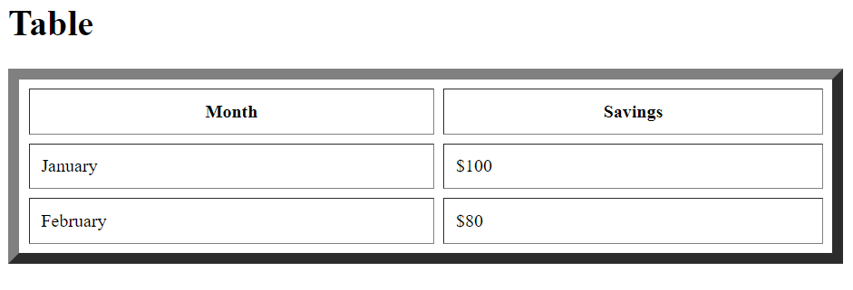

Slide 6
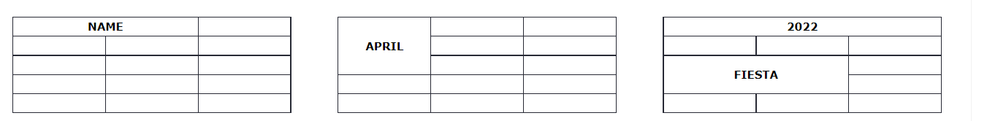
Spanning Multiple Rows or Columns
The tables you've created up to this point all had one value per cell or the occasional empty cell. You also can create cells that span multiple rows or columns within the table. Those spanned cells then can hold headings that have subheadings in the next row or column or you can create other special effects within the table layout.

Slide 7
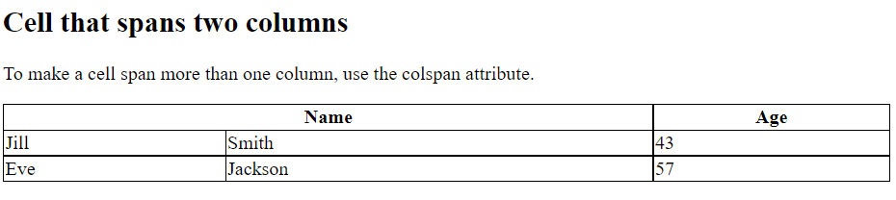
columnspan
<table style="width:100%">
<tr>
<th colspan="2">Name</th>
<th>Age</th>
</tr>
<tr>
<td>Jill</td>
<td>Smith</td>
<td>43</td>
</tr>
<tr>
<td>Eve</td>
<td>Jackson</td>
<td>57</td>
</tr>
</table>
</body>
</html>

Slide 8
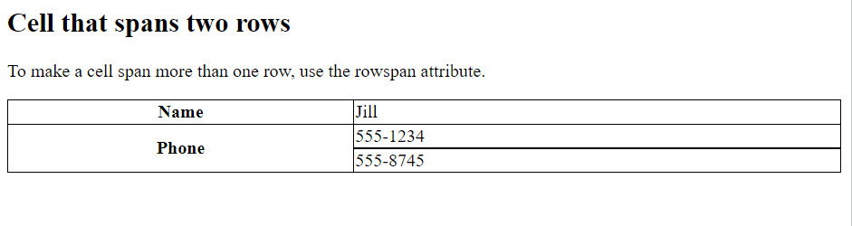
rowspan
<table style="width:100%">
<tr>
<th>Name</th>
<td>Jill</td>
</tr>
<tr>
<th rowspan="2">Phone</th>
<td>555-1234</td>
</tr>
<tr>
<td>555-8745</td>
</tr>
</table>

Slide 9
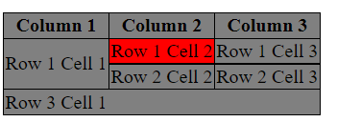
<table border="5" bordercolor="green" bgcolor="gray">
<tr>
<th>Column 1</th>
<th>Column 2</th>
<th>Column 3</th>
</tr>
<tr><td rowspan="2">Row 1 Cell 1</td>
<td bgcolor="red">Row 1 Cell 2</td><td>Row 1 Cell 3</td></tr>
<tr><td>Row 2 Cell 2</td><td>Row 2 Cell 3</td></tr>
<tr><td colspan="3">Row 3 Cell 1</td></tr>
</table>

Slide 10
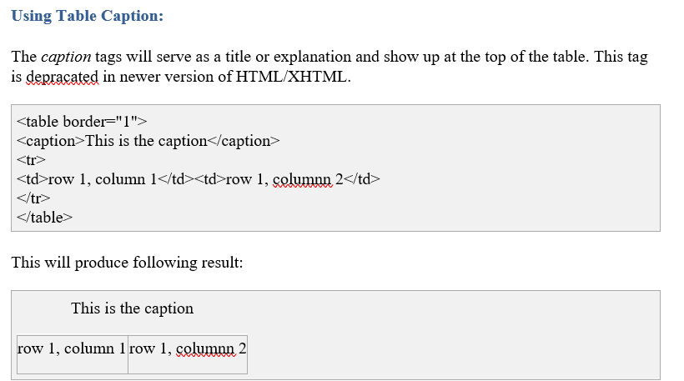

Slide 11
HTML Layout - Using Tables:
<table width="100%" border="0">
<tr>
<td colspan="2" style="background-color:#CC99FF;">
<h1>This is Web Page Main title</h1>
</td>
</tr>
<tr valign="top">
<td style="background-color:#FFCCFF;
width:100px;text-align:top;">
<b>Main Menu</b><br />
HTML<br />
PHP<br />
PERL...
</td>
<td style="background-color:#eeeeee;height:200px;
width:300px;text-align:top;">
Technical and Managerial Tutorials
</td>
</tr>
<tr>
<td colspan="2" style="background-color:#CC99FF;">
<center>
Copyright © 2007 Tutorialspoint.com
</center>
</td>
</tr>
</table>

Slide 13
Multiuple Columns Layouts - Using Tables
<table width="100%" border="0">
<tr valign="top">
<td style="background-color:#FFCCFF;width:20%;
text-align:top;">
<b>Main Menu</b><br />
HTML<br />
PHP<br />
PERL...
</td>
<td style="background-color:#eeeeee;height:200px;
width:60%;text-align:top;">
Technical and Managerial Tutorials
</td>
<td style="background-color:#FFCCFF;
width:20%;text-align:top;">
<b>Right Menu</b><br />
HTML<br />
PHP<br />
PERL...
</td>
</tr>
<table>

Slide 15
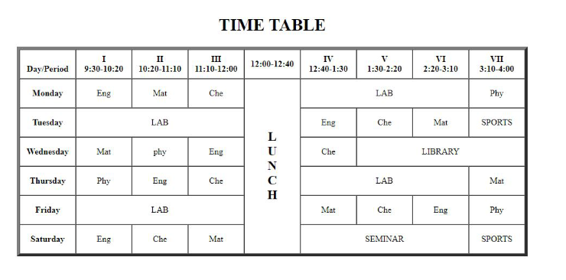
Time table using HTML

Slide 16
<body>
<h1>TIME TABLE</h1>
<table border="5" cellspacing="0" align="center">
<!--<caption>Timetable</caption>-->
<tr>
<td align="center" height="50"
width="100"><br>
<b>Day/Period</b></br>
</td>
<td align="center" height="50"
width="100">
<b>I<br>9:30-10:20</b>
</td>
<td align="center" height="50"
width="100">
<b>II<br>10:20-11:10</b>
</td>
<td align="center" height="50"
width="100">
<b>III<br>11:10-12:00</b>

Slide 17
</td>
<td align="center" height="50"
width="100">
<b>12:00-12:40</b>
</td>
<td align="center" height="50"
width="100">
<b>IV<br>12:40-1:30</b>
</td>
<td align="center" height="50"
width="100">
<b>V<br>1:30-2:20</b>
</td>
<td align="center" height="50"
width="100">
<b>VI<br>2:20-3:10</b>
</td>
<td align="center" height="50"
width="100">
<b>VII<br>3:10-4:00</b>
</td>
</tr>

Slide 18
<tr>
<td align="center" height="50">
<b>Monday</b></td>
<td align="center" height="50">Eng</td>
<td align="center" height="50">Mat</td>
<td align="center" height="50">Che</td>
<td rowspan="6" align="center" height="50">
<h2>L<br>U<br>N<br>C<br>H</h2>
</td>
<td colspan="3" align="center"
height="50">LAB</td>
<td align="center" height="50">Phy</td>
</tr>
<tr>
<td align="center" height="50">
<b>Tuesday</b>
</td>
<td colspan="3" align="center"
height="50">LAB
</td>
<td align="center" height="50">Eng</td>
<td align="center" height="50">Che</td>
<td align="center" height="50">Mat</td>
<td align="center" height="50">SPORTS</td>
</tr>

Slide 19
<tr>
<td align="center" height="50">
<b>Wednesday</b>
</td>
<td align="center" height="50">Mat</td>
<td align="center" height="50">phy</td>
<td align="center" height="50">Eng</td>
<td align="center" height="50">Che</td>
<td colspan="3" align="center"
height="50">LIBRARY
</td>
</tr>
<tr>
<td align="center" height="50">
<b>Thursday</b>
</td>
<td align="center" height="50">Phy</td>
<td align="center" height="50">Eng</td>
<td align="center" height="50">Che</td>
<td colspan="3" align="center"
height="50">LAB
</td>
<td align="center" height="50">Mat</td>
</tr>

Slide 20
<tr>
<td align="center" height="50">
<b>Friday</b>
</td>
<td colspan="3" align="center"
height="50">LAB
</td>
<td align="center" height="50">Mat</td>
<td align="center" height="50">Che</td>
<td align="center" height="50">Eng</td>
<td align="center" height="50">Phy</td>
</tr>
<tr>
<td align="center" height="50">
<b>Saturday</b>
</td>
<td align="center" height="50">Eng</td>
<td align="center" height="50">Che</td>
<td align="center" height="50">Mat</td>
<td colspan="3" align="center"
height="50">SEMINAR
</td>
<td align="center" height="50">SPORTS</td>
</tr>
</table>
</body>

